Slide 1

Samsung PRISM Mid Review Report
STATISTICAL LEARNING BASED CONGESTION DETECTION AND CONTROL
Worklet ID: CSW18KCT
College Professor(s): Ms.D.Aswini , X.Francis Jency
Students:
Bothiprasaadh S P
Janani P
Vedha Smritha S
Department: Computer science and engineering

Slide 2

Work-let Area – Statistical Learning based Congestion Detection and Control
3
Work-let expected duration – 6 months
Members
Problem Statement/Objective
Optimal congestion control along with low latency, high throughput, good adaptability and fair bandwidth allocation is a critical challenge in telecom domain, mainly because of the hardwired control strategy and egocentric convergence objective.
To address these issues, we require statistical learning based congestion detection and control mechanism to achieve optimal tradeoff.
The key objective of this worklet is to provide a efficient approach for congestion detection and control in traffic flows.
This worklet intends to propose statistical learning based approach(es) to predict a possible congestion detection considering different dimensions (for example but not limiting to - time of the day, geographical location, type of service, and user preferences).
Business Impact
This algorithm can be utilized in various products for providing an optimized congestion detection and control algorithm.
Samsung network business needs to show edge over its competitors. This worklet can help in optimization of the QoE enhancement feature design and hence help in achieving better performance goals.
Expectations
Using simulation tools such as Matlab/NS-3, OpNet network simulator, Python event simulation, simulate congestion scenarios and propose Statistical Learning based congestion detection and Control.
To Propose a Statistical based congestion control mechanism on a given traffic flow.
To detect elephant and mice flows using statistical learning methods
To compare the results with the state-of-the-art Statistical approach(es) and algorithms.
Establish the superiority of the proposed algorithm i.e., why/in what real-time scenarios the proposed algorithm is better than the state-of-the-art algorithm with which the results are compared (on what metrics).
To determine input factors (dimensions) and their impact on the optimal solution.
To demonstrate the Proof of Concept (PoC) of the above mentioned proposed approaches.
To provide detailed empirical results establishing the efficacy of the proposed approach/approaches.
Publish Paper.
Training/ Pre-requisites
Internet Traffic Flow (QUIC/TCP flows).
TCP Protocol, Congestion Control algos.
Simulation environment.
Kick Off < 1st Month >
Study TCP based protocols and congestion control.
Study existing Statistical learning based approaches/algorithms.
Milestone 1 < 2nd Month >
Determine factors for the proposed algorithm.
Design draft of the proposed algorithm
Milestone 2 < 3nd Month >
Compare results of the proposed algorithm with existing algorithms.
Scope for further improvement to be analysed
Milestone 3 < 4th Month >
Demo
Publish Final Results
Amit Goel
Rajesh Challa
Additional Documentation:
https://dl.acm.org/doi/pdf/10.1145/3422604.3425939
https://ieeexplore.ieee.org/document/8931660

Slide 3
Proposed Approach / Solution
Concept Diagram :
Decide a statistical
Congestion control
Algorithm
Retrieve dataset
Detect elephant and
Mice flow
Optimisation of
Result
Ensuring consistency in
the flow of TCP
Congestion control
using regression algorithm

Slide 4
Work-let Name: Statistical Learning based Congestion Detection and Control
Worklet Details
Worklet ID: CSW18KCT
College Name: Kumaraguru college of technology
Studied existing Statistical learning based approach/algorithms.
Draft is designed for the proposed algorithm
Results of the proposed algorithm tested .
Can't able to get results of various similar solutions other than our proposed solution.
KPIs achieved till now
Any Challenges/ Issues faced
Next Steps
To optimize the result .
Results of proposed algorithm is obtained
Key Achievements/ Outcome till now
Date: 28/06/2022

Slide 5
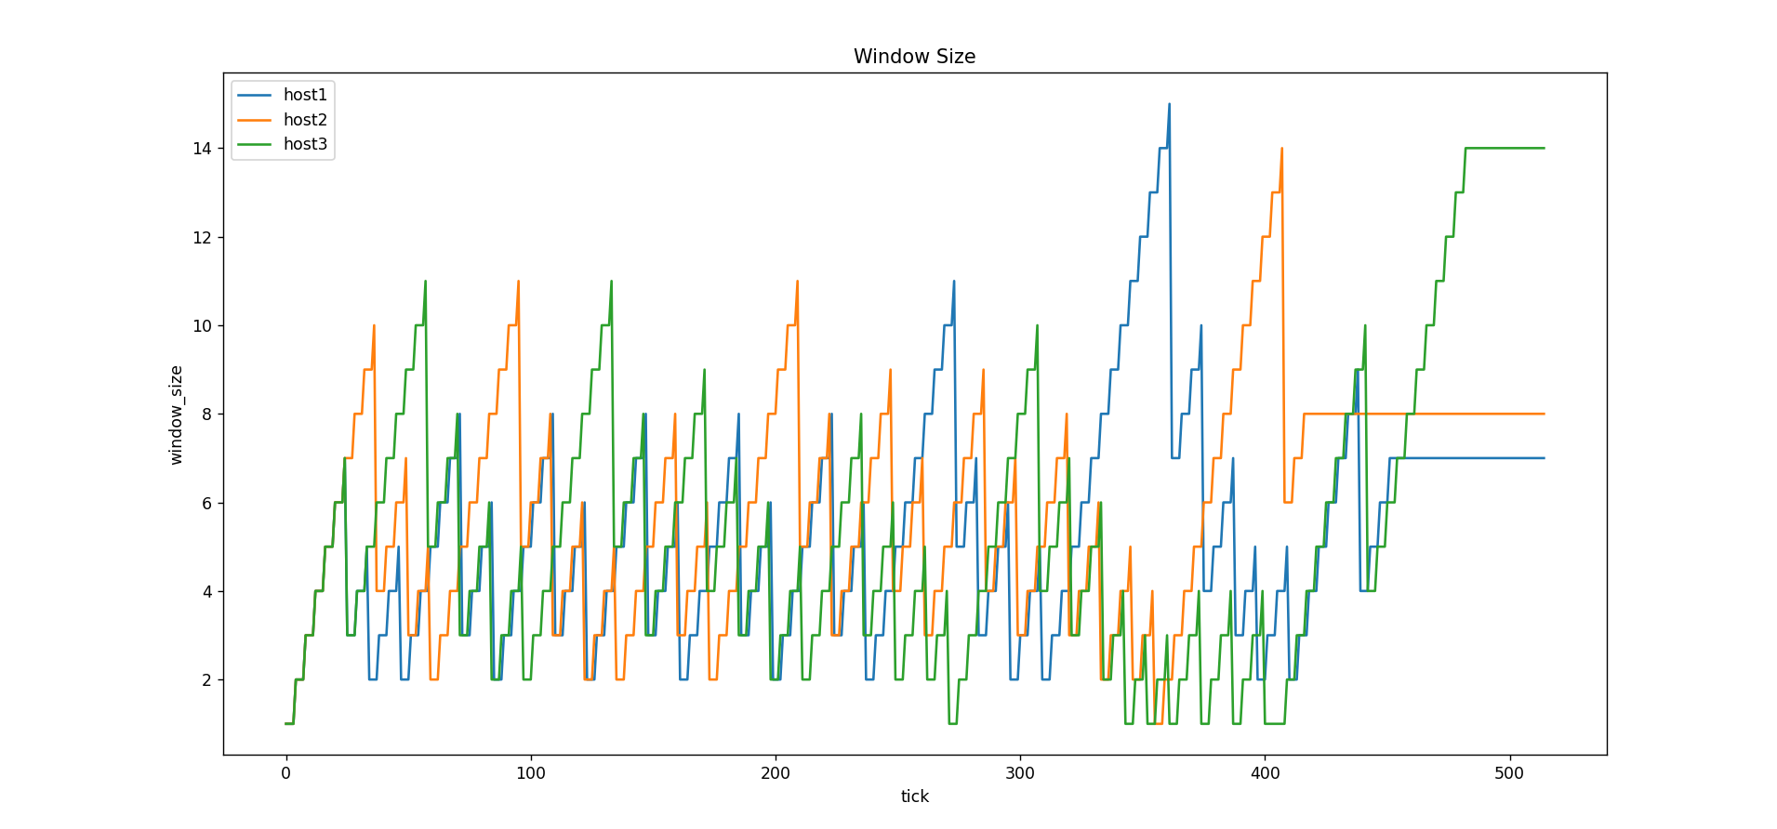
Experimental Results / Simulations / Observations
Results :
(provide numerical data / bar charts / plots / images / videos / tabulated results etc. Use full slide or multiple slides up to max 3 slides to demonstrate the results)

Slide 6
Thank you

